Slide 1

NATIONAL POST OFFICE BUSINESS IDEAS
PRESETED BY: UWIZEWE JEAN D’AMOUR

Slide 2
Agenda
00
Why we are in this room
01
NPO Last five years Revenue (2017-2021(Nov))
02
My Question ?
Why National Post Office
What is future of National Post
What we can do to get 3 billions in next three year, 5 billons in five year,
03
Business ideas
Smart office
Digital Payment
Digital address
e-stamp and e-document
04
Strategies for achieving his dreams

Slide 3
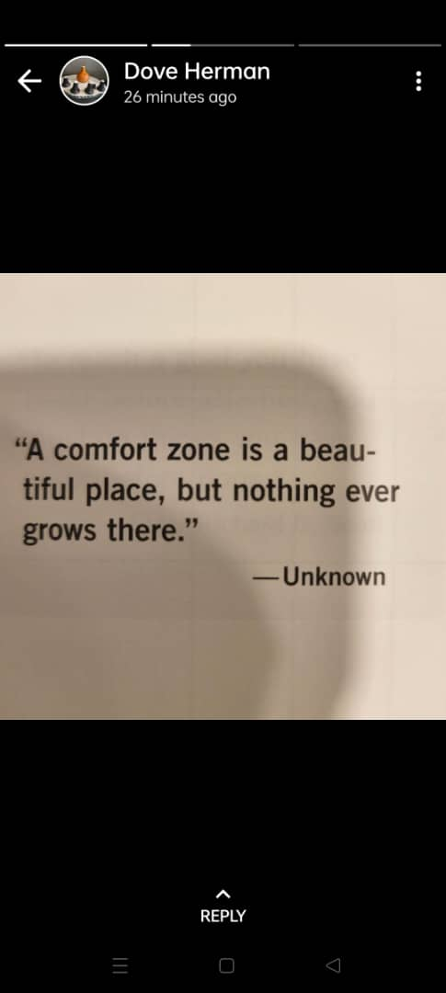
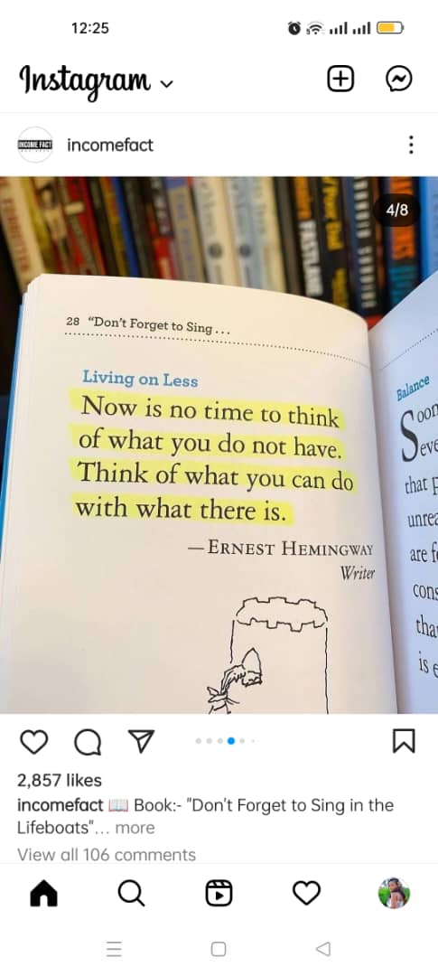
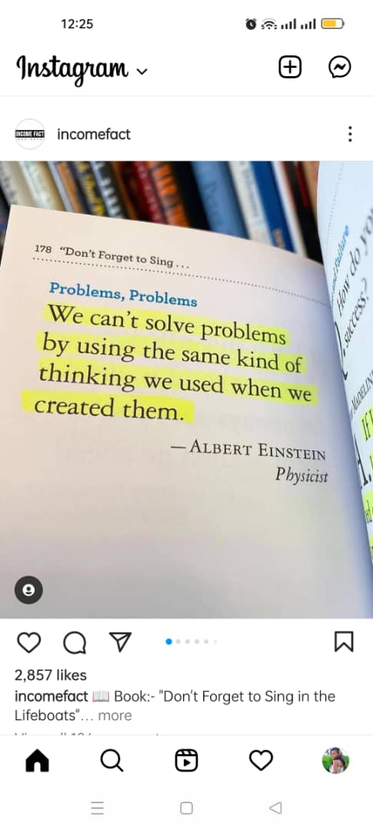
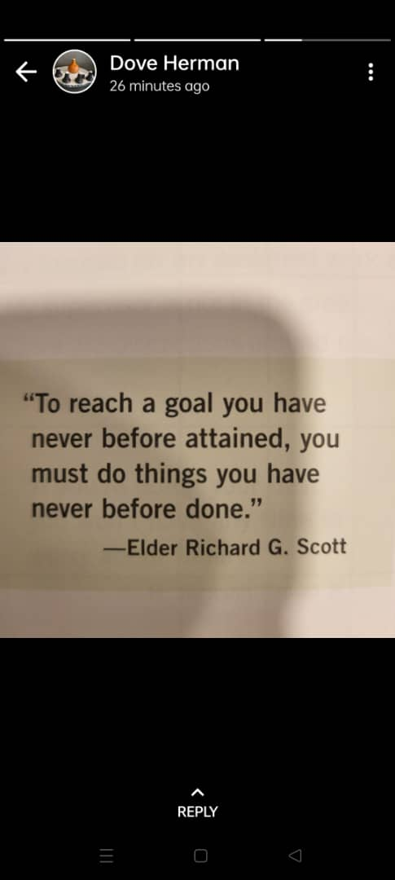
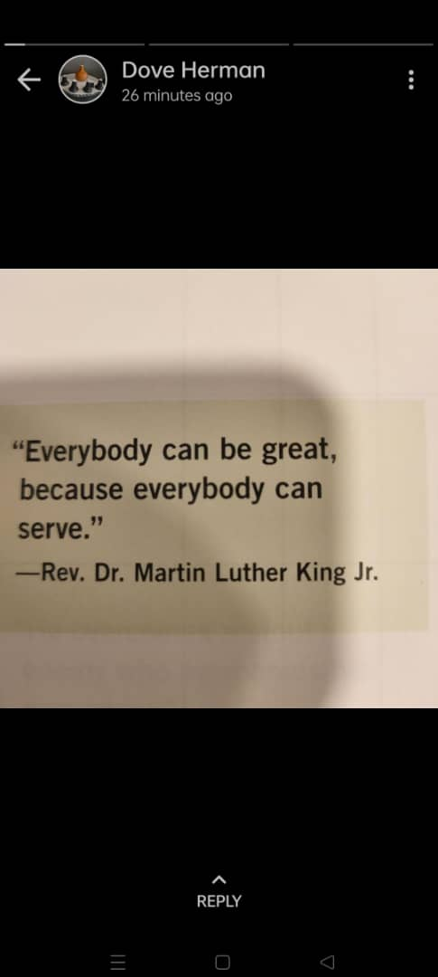
0)WHY WE ARE IN THIS ROOM

Slide 4

1)NPO LAST FIVE YEARS REVENUES
2021(Nov)
1,645,310,604
2018
2020
1,222,687,444.
2019
1,440,221,727.
1,254,783,129.
2017
1,110,736,827.

Slide 5
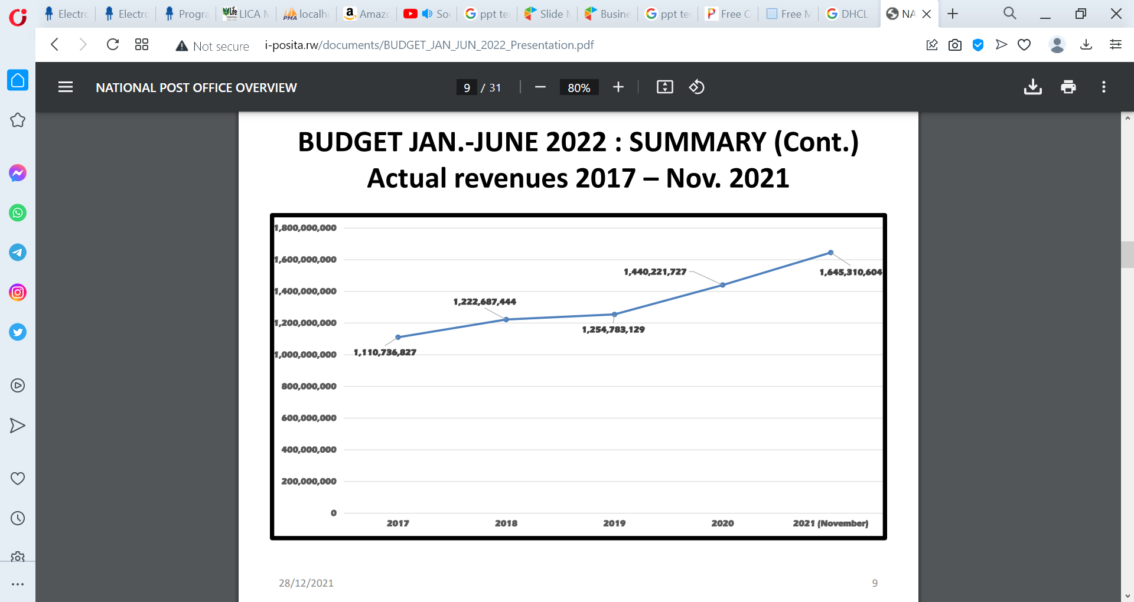
FIVE YEARS REVENUES
2021(Nov)
1,645,310,604
2018
2020
1,222,687,444.
2019
1,440,221,727.
1,254,783,129.
2017
1,110,736,827.

Slide 6
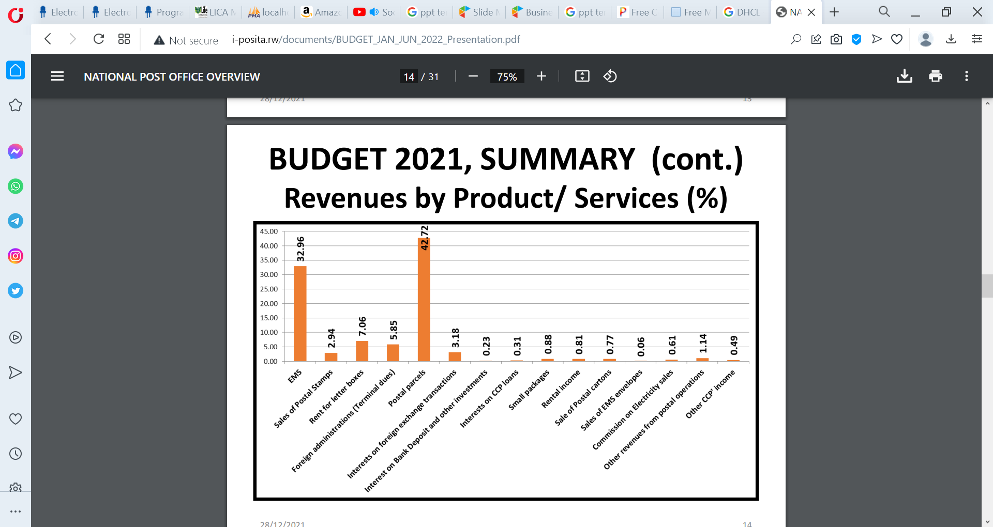

Slide 7

Why NPO Revenue is constant???? (1.5B)

Slide 8
What is future of National Post Office
In five years or
ten years ??????

Slide 9

What we can do to get 3 billions in next three year, 5 billons in five year,
2024
2025
2026
2027
2 Billons
3 Billions
4Billions
5 Billions .

Slide 10

EPR SYSTEM (SMART OFFICE)
STORE MANAGEMENT
IMMS
P.O MANAGEMENT
MAIL MANAGEMENT
INCOME REGISTRATION
PRINTED MATERIAL FORMAT .
WEBSITE (PUBLIC GATWAY)
SAGE, EBM, SMART ADMIN, FINANCE SOLUTION, SMART HR, CDS, IPS , WEBEX
POD AND INVOICE GENERATION
VEHICLE MANAGEMENT
FICHE DE TRANSMISSION AND ADMINSTRATION

Slide 11
DIGITAL ADDRESS SYSTEM
GPS ADDRESS (HOME, OFFICE, PUBLIC SPACE)
VISITON REGISTRATION INTEGRATED WITH NIDA AND MTN
PHYSICAL PO BOX (INTEGRATED WITH RDB, RURA, UMUCYO)
BOITE DE SUGGESTION
.
VIRTUAL P.O BOX (INTEGRATED WITH RURA, RDB, UMUCYO SYSTEM)
LOSTED ITEMS
LAST MAIL DELIVERY (LOAD AFRICA SYSTEM)
MARKETING AND MEMBERSHIP MANAGEMTN

Slide 12

PAYEMENT SYSTEM
School Fees Payment
WATER ELETRICITY
RRA FEE COLLECTIONS
E-COMERCE PAYEMENT GATWAY
RSSB +EJO HEZA

Slide 13
E-STAMP & E-DOCUMENT
Document Stamping
Documents sharing
Document originality authentication
e-notary seal

Slide 14
TARGET CLIENT
Government institution officers
School
Hospital and Health center
ChurchS
NGOs
Banks
PSF member shops
Public space ( Gare, Martkt)
Etc……
Young People
Adults People
70%
60%
30%
20%

Slide 15
IPOSITA INNOVATION TEAM
OUTPUT
TEAM
PLANNING
EXCUTION
MONITORING
REPORTING

Slide 16
FUNNY SWTO
STRENGTHS
NAME : IPOSITA
STATUS Government institution
MINICT
S
TURASINZIYE
WEAKNESS
T
W
OPPORTUNITIES
DEVELOPMENT OF TECHNOLOGY
MODERN SERVICE
O
THREATS
BAMUKEBA

Slide 17

Thank you

